Slide 1
Sample Introduction For Science
New Product Introduction – ASX-560

Slide 2
Topics
What you will learn:
  How the ASX-560 improves on the features and performance of the ASX-520
  Easier software controls for the ASX-560
  How the ASX-560 is more resistant to corrosive chemicals
  How the ASX-560 is easier to service
  How CETAC engineered the ASX-560 to be even more reliable than its predecessor
  New accessory interfaces and expansion capabilities
  Additional ASX-5xx instruments

Slide 3
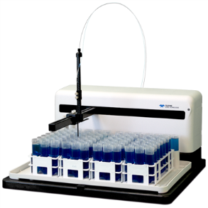
ASX-560 Strategic Position
The Analytical Instrument Process
Sample collection
Sample treatment / preparation
Sample introduction
Data output / handling
Measurement

Slide 4
How Did We Get Here?
ASX-500, Launched in 1993
  General purpose autosampler
    AC input (2 internal power supplies), fan, external pump, no coatings
ASX-510, Launched in 1997
    External 24V, no fan, pump, coated lead screws, CE certification
ASX-520, Launched in 2003/2004
    New corrosion resistance measures:
      Conformal electronics coating, Armoloy guide shaft coating, Krytox packed bearings, plastic splash guard, carbon fiber probes (previously SS or Ultem)
    New features:
      High Speed versions available, USB and Serial communications, new reprogrammable firmware with rabbit board, anti-kink option, new pump
ASX-560, Launched in 2015
    New generation of new features and improved corrosion resistance
Approximately 20,000 autosamplers currently in the field

Slide 5

New Benefits and Features
Updated Materials
Carbon Fiber: Y & Z Axis
Polypropylene: Cover, Rinse, Tray
Polycarbonate: Sampler Base
PET/PBT: Sliders, Z-axis rotor/stator
Strong, lightweight, chemical resistance (acids, oils, chromatography solvents)
Low contamination potential
Same robust drive train components as ASX-520
Life tested over 7M cycles

Slide 6
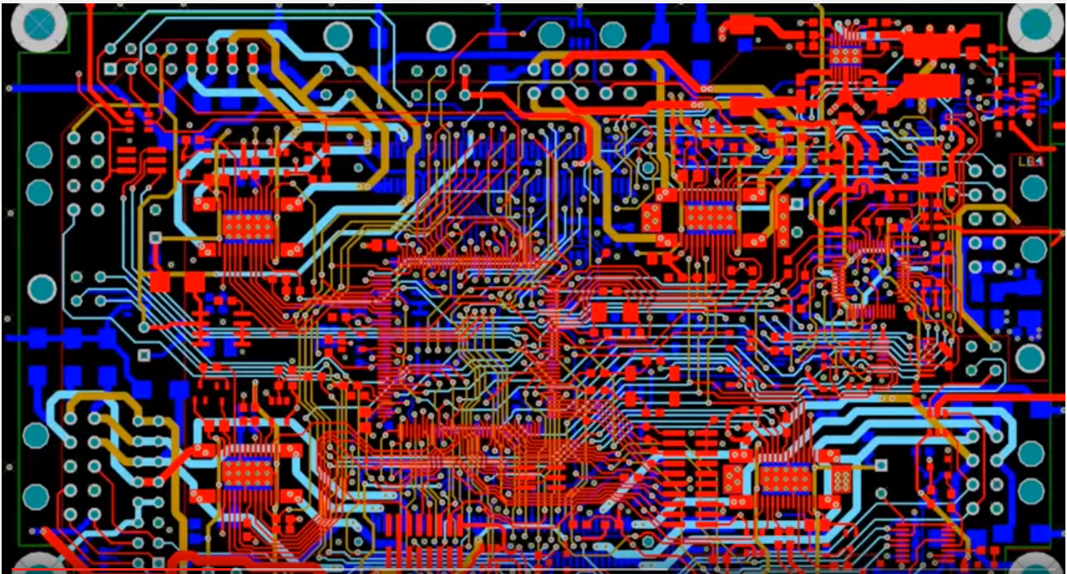
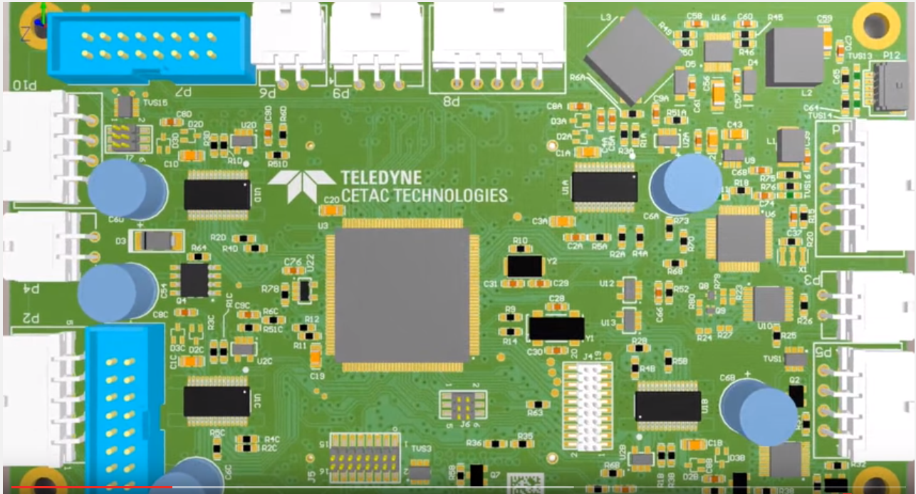
New Benefits and Features
All New Electronics
Best In Class Stepper Motor Drivers
1/128th Step Control
Six Layer Design
Vertical Mount, Conformal Coating
Custom motion profiles
Anti-Backlash Movement
Improved Accuracy and Precision– 96 WP
Never travels over un-ran samples
Soft Alignment, Zone Alignment
Improved Speed Control
Quieter, Configurable Pump Speed
Improved firmware security and updates
100% Backward Compatible Commands

Slide 7
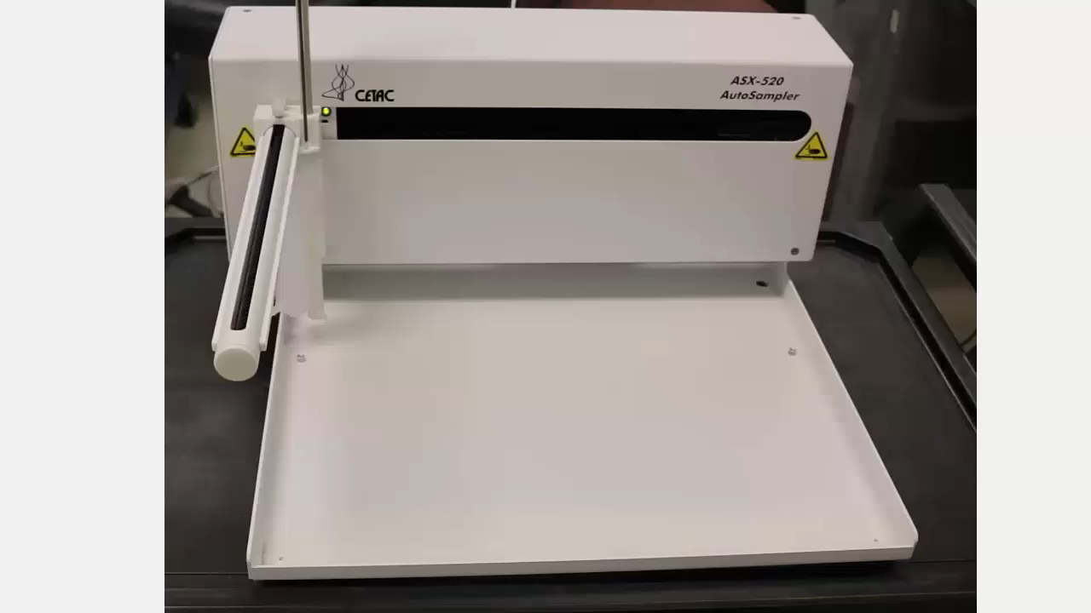
Motion Profiles
ASX-520, XYZ Movement

Slide 8
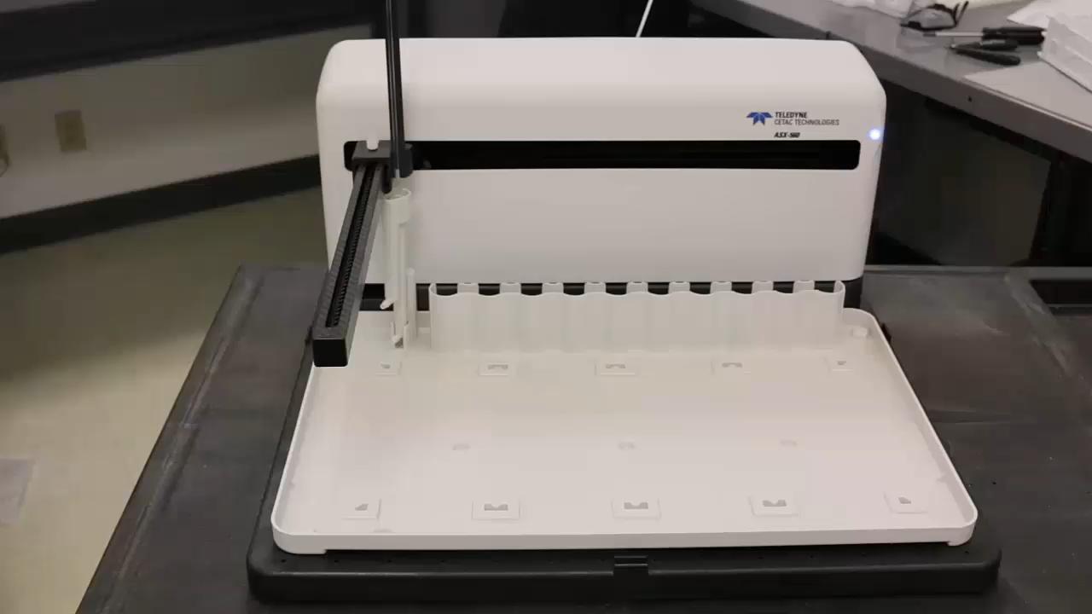
Motion Profiles
ASX-560, XYZ Movement

Slide 9
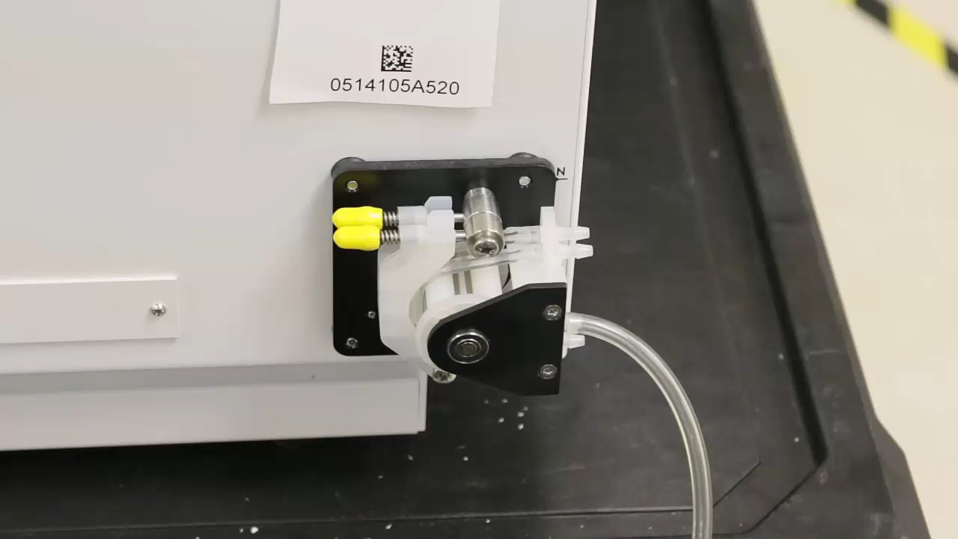
Pump Control
ASX-520 Peristaltic Pump Default, ~10mL/min

Slide 10
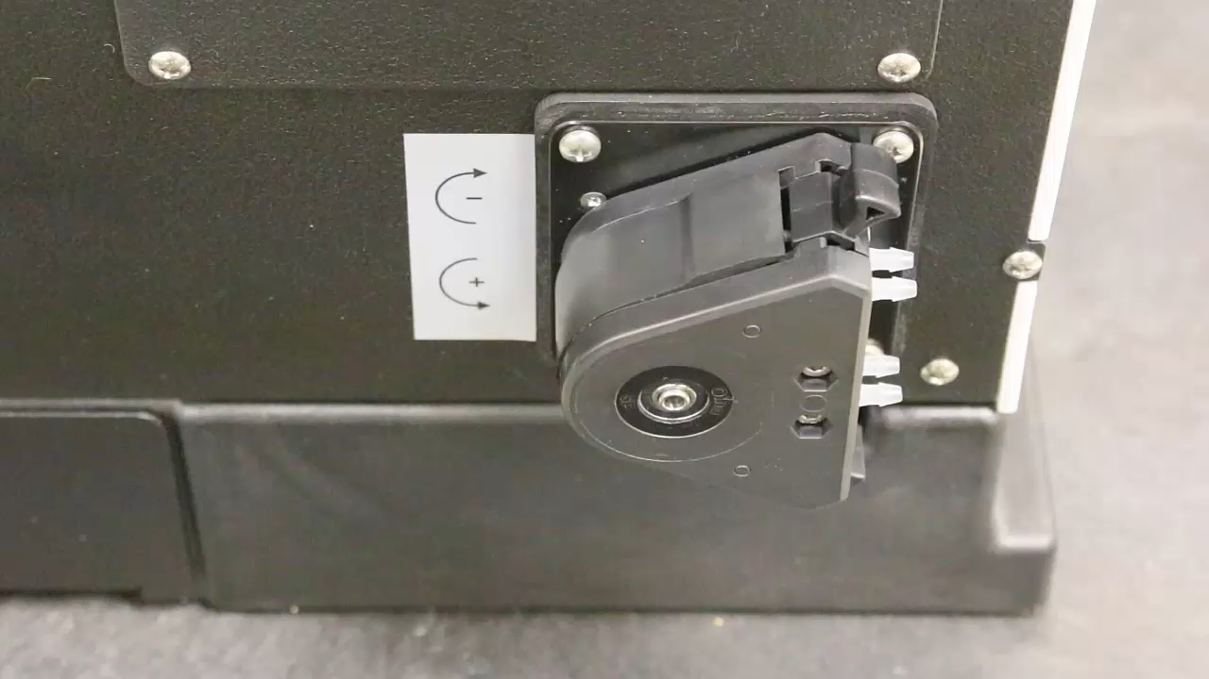
Pump Control
ASX-560 Peristaltic Pump Default, ~10mL/min

Slide 11
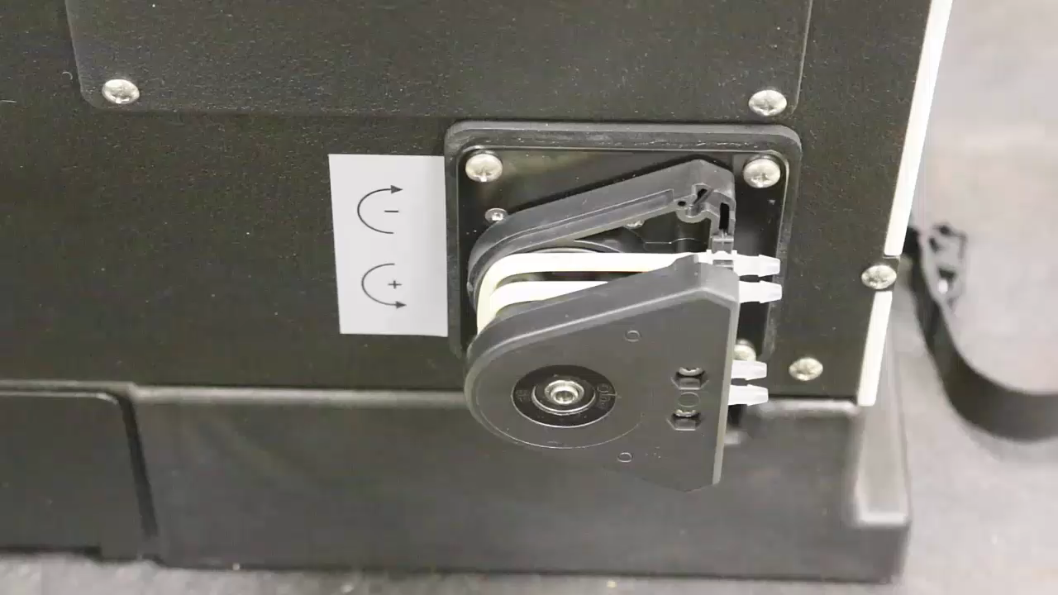
Pump Control
ASX-560 Peristaltic Pump, 0.8 – 80 mL/min

Slide 12
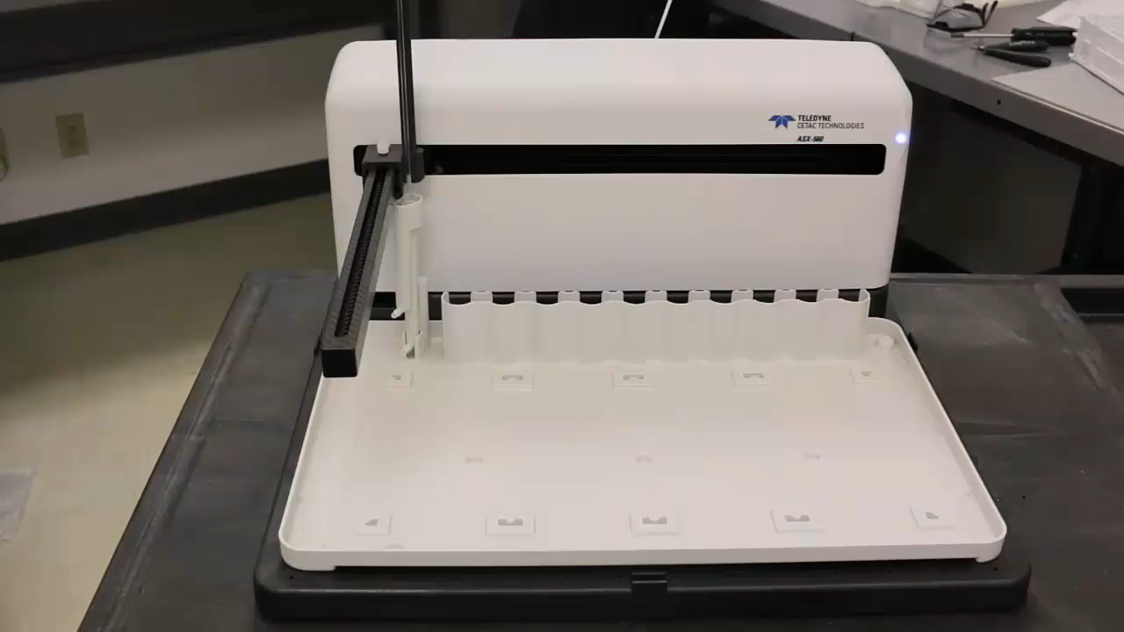
Movement Control– High Speed
ASX-560, H.S. Configuration

Slide 13
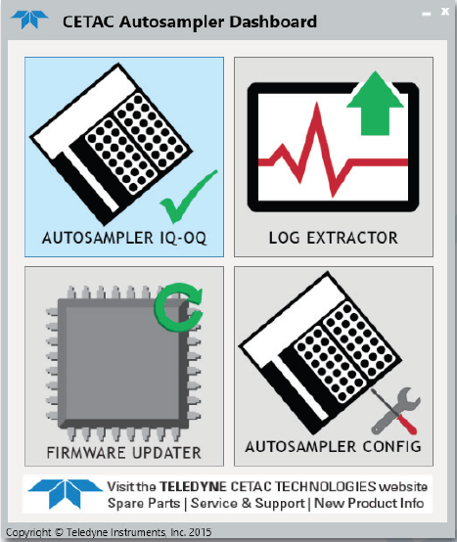
New Benefits and Features
Software Control
Dashboard Software:
  Autosampler IQ/OQ
  Autosampler Configuration
  Autosampler Log Extractor
  Firmware Field Programming

Slide 14
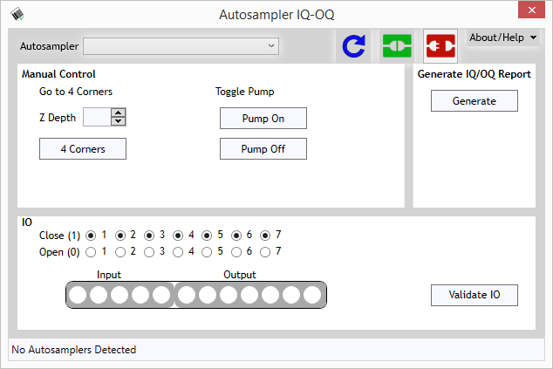
Software Control
Autosampler IQ/OQ
Features:
  Installation verification
  Functionality testing
    Pump
    IO (on/off)
    XYZ Movement
  Text file report

Slide 15
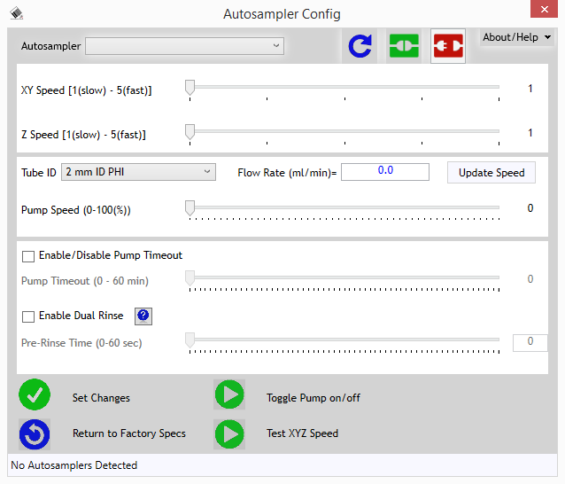
Software Control
Autosampler Configuration Utility
Features:
  XYZ Movement Speeds
    Settings 1 - 5
  Pump Speed
    0.8 – 80 mL/min
  Pump Timeout
    Default “off”
  Dual Rinse
    Independent of OEM

Slide 16
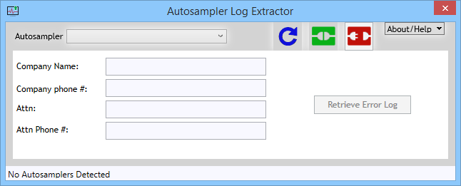
Software Control
Autosampler Log Extractor
Features:
  Tool for Service
  Text file report
  Email for support

Slide 17
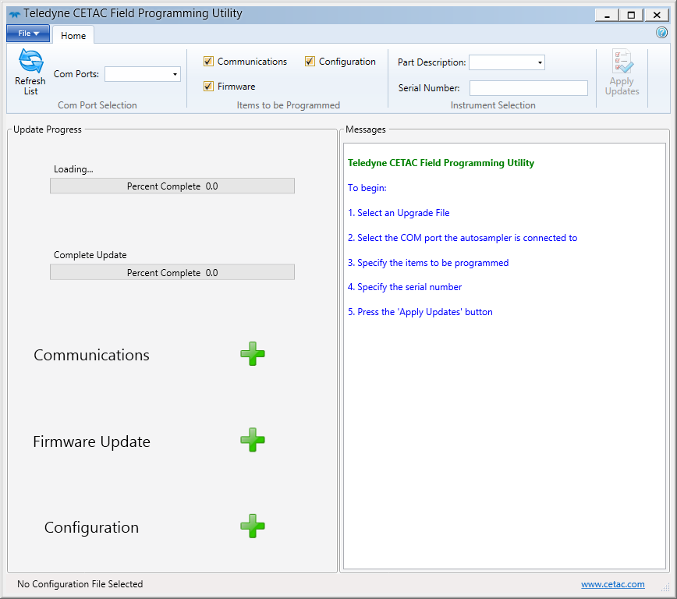
Software Control
Firmware Field Programming Tool
Features:
  Easier FW Updates
  Unique OEM Files
    Eliminates Personalities
  Easy to update/install
  Hardware Changes not necessary

Slide 18
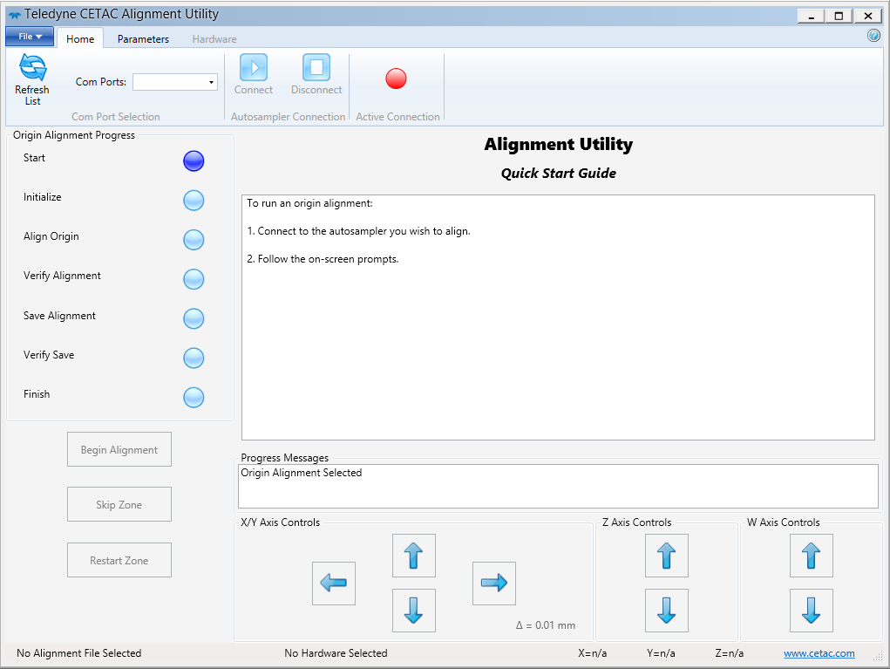
Software Control
Alignment Utility
Features:
  Electronic Home Offset
    Not Mechanical
  Alignment Zones
    Eliminates Variability
    Unique HW Files
  Saved to Main Board
    Aligned at factory
    Non-volatile memory
    FW updates won’t erase
  Improved Accuracy
    MT 96 Plates

Slide 19
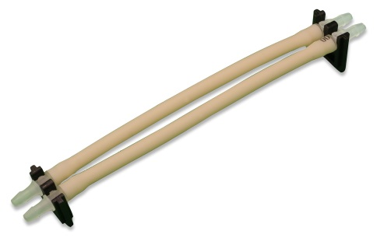
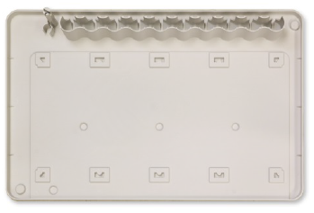
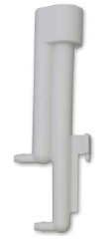
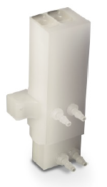
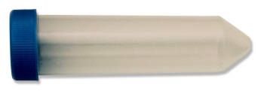
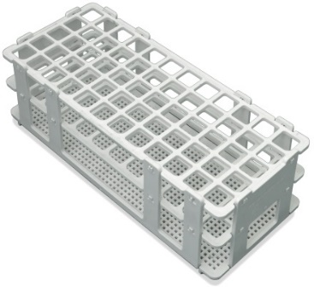
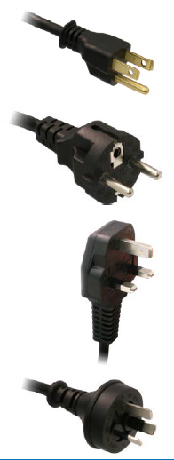
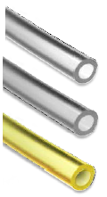
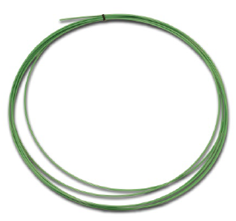
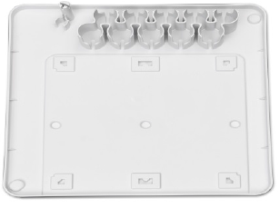
Consumable Parts

Slide 20
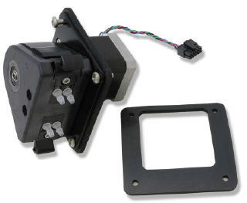
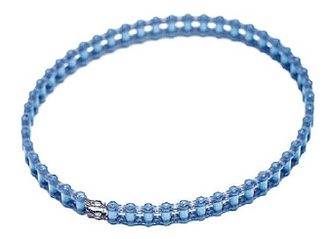
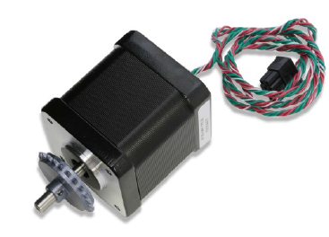
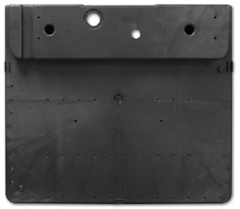
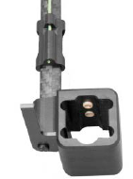
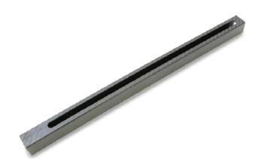
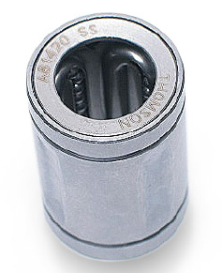
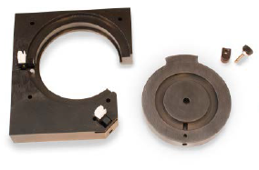
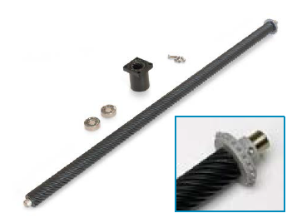
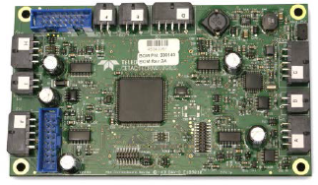
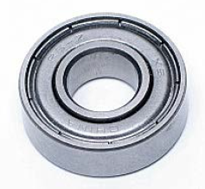
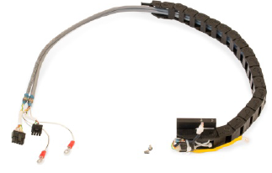
Repair Parts

Slide 21
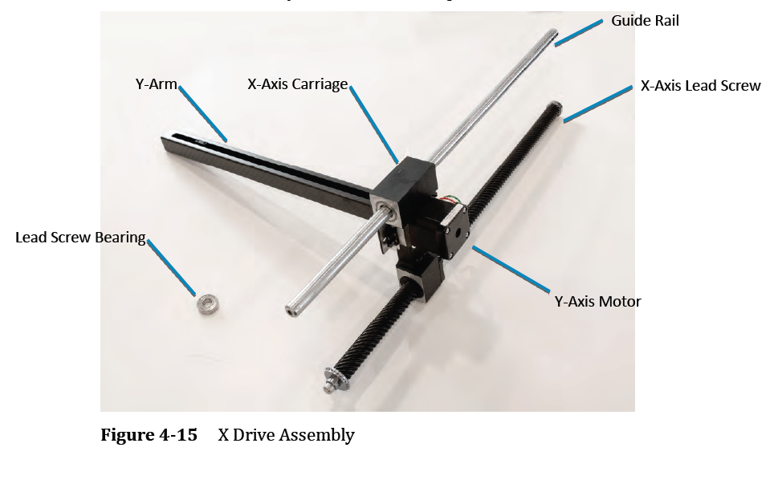
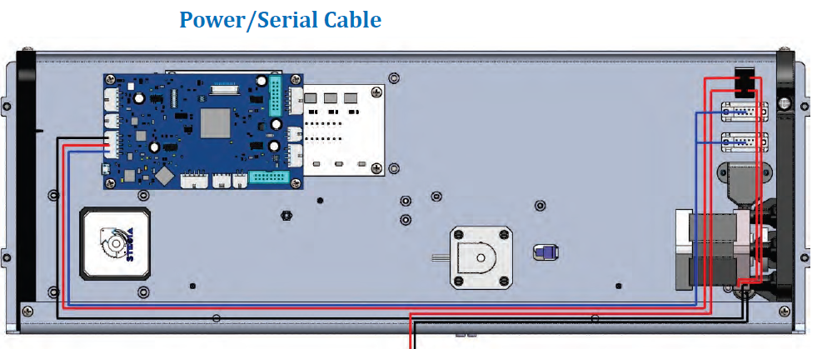
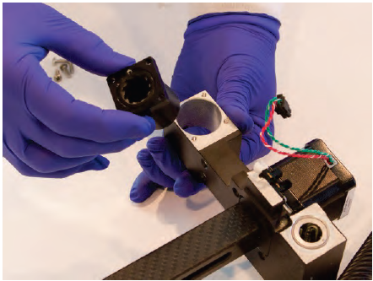
Repair Guides
Service Manual available for Download
    Error Message Database
    Installation Guides
    Troubleshooting Guides
    Detailed Repair Instructions
    Detailed Service Webinars Planned

Slide 22
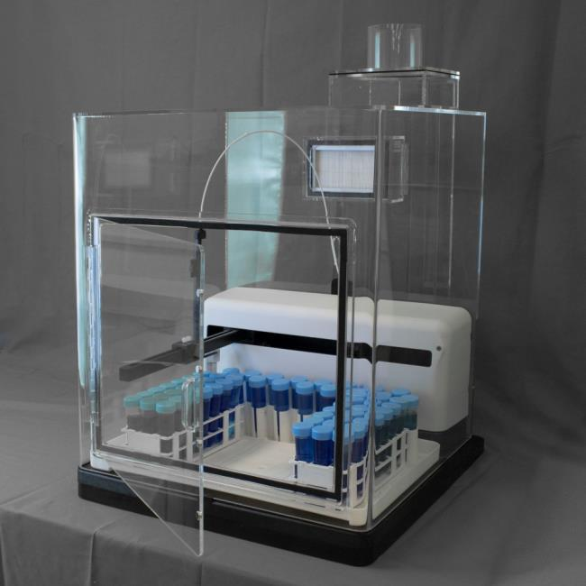
Expansion Capabilities
Integrated Enclosure, ENC-560
Available As 560 Upgrade
Or, Can Ship Pre-Installed
Available In January, 2016

Slide 23
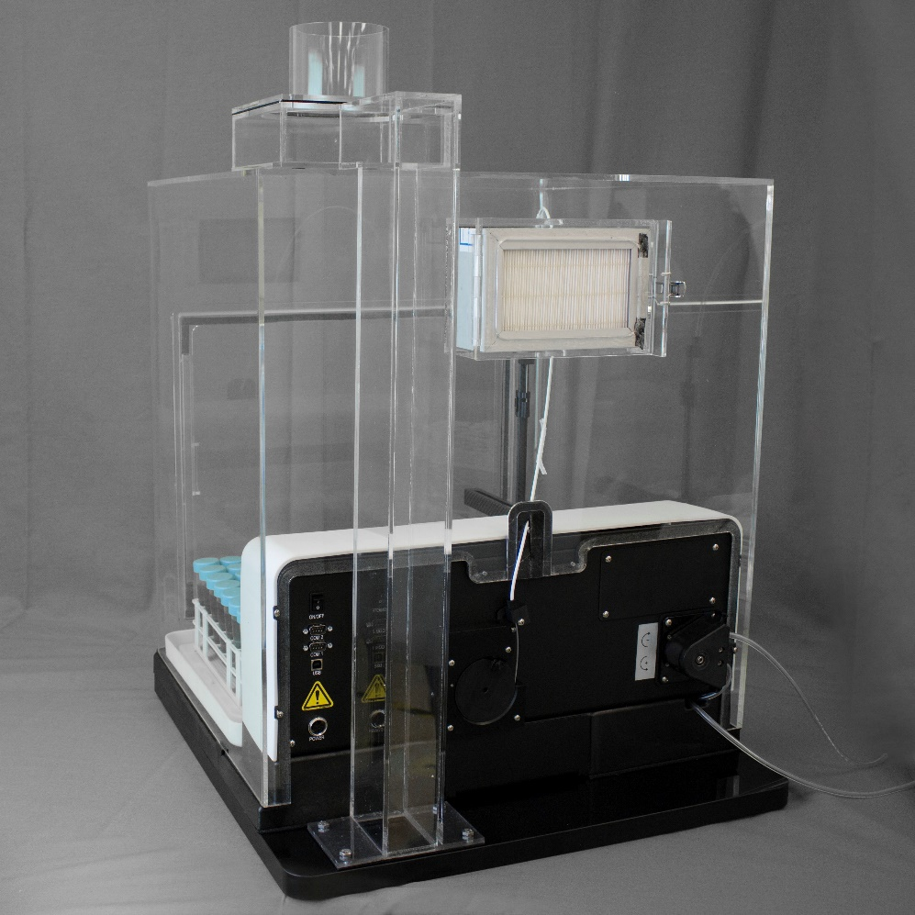
ENC-560
HEPA Filtration
Integrated Footprint
No Metal Components
Low Contamination
Reversible Door
Accessible Components
Flexible Attachments
  Vent Connections, Bulkheads
No Additional Bench Space

Slide 24

ENC-560 Integrated Enclosure

Slide 25
Expansion Capabilities
ASXPress
  100% Backward Compatible with ASX-560
Dual Rinse
  Optional Spare Part Upgrade
  Orderable As Stand Alone
  Configurable via Dashboard Utility
    Compatible With All OEM Software
Additional Expansion Capabilities
  Additional Power and Communications Cables Pre-Installed
  37-pin AUX Board Available as SP Upgrade or Standard

Slide 26
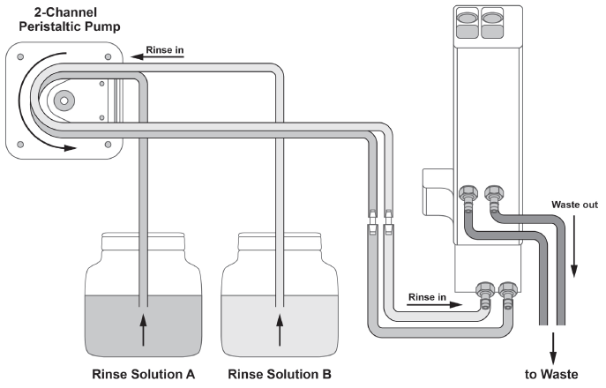
Dual Rinse
Multiple Rinse Solutions
For Problem Carryover Applications
  Sticky Elements
  Organics/Fats
  HCl added, etc.
Gravity Drain
Tubing Kits Included

Slide 27
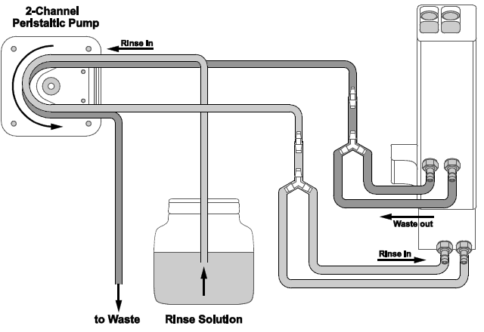
Dual Rinse
Single Rinse Solution
For Problem Carryover Applications
  Dirty vs. Clean Stations
Active Drain Pump
  Gravity drain unnecessary
Tubing Kit Included

Slide 28
Dual Rinse– Active Pump

Slide 29
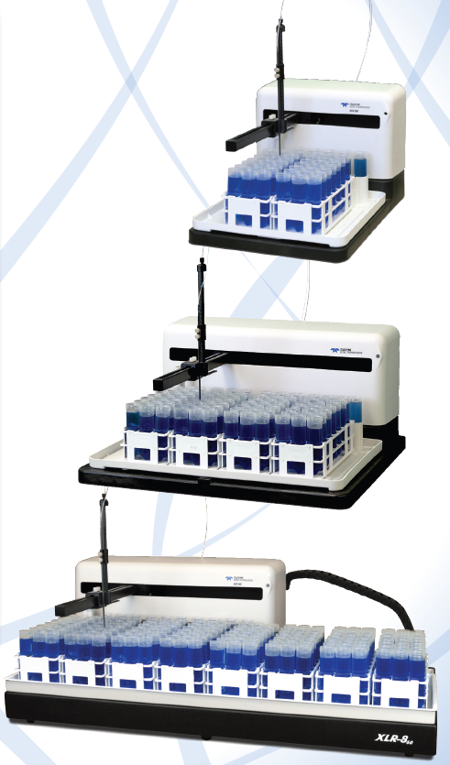
Additional 500 Family
ASX-280
  2-Rack Solution
  Released, available now
  Dual Rinse and ASXPress are available now
ASX-560
  4-Rack Solution
  Released, autosampler available now
  Dual Rinse and ASXPress are available now
  Enclosure available for shipments in January, 2016
XLR-860
  8-Rack Solution
  Available In December, 2015

Slide 30
Frequently Asked Questions
Price
  Contact local dealer, sales, or OEM
  http://www.cetac.com/contact/page/sales-contacts.htm
Lead Time
  Currently 8 weeks
  Will reduce to 6 weeks in November, 2015
  Will reduce to 4 weeks
Service and Support– OEM or Factory
  CETAC supports instrumentation for 7 years
  Loaner program
  2 year warranty
  3 year warranty upgrade is available

Slide 31
Questions?
Please Contact:
Jon Peters
Automation Product Manager jon.peters@Teledyne.com

